Slide 1
Loma Linda University Web of Science: Basic Search

Slide 2
Loma Linda University
Web of Science Core Collection holdings
Science Citation Index Expanded
(8634 journals, See journal list)
Social Sciences Citation Index
(3131 journals, See journal list)

Slide 3
Indexing practices and benefits
Cover-to-cover indexing of almost 12,000 journals
Everything is indexed (letters, editorials, reviews, articles, etc.)
International
Influential
Thomson Reuters Journal Selection Process
Key benefits
Includes the entire list of works cited by an article
References are searchable and navigable

Slide 4
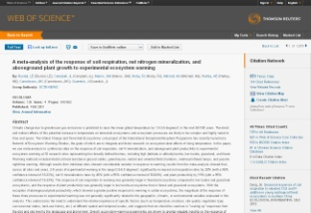
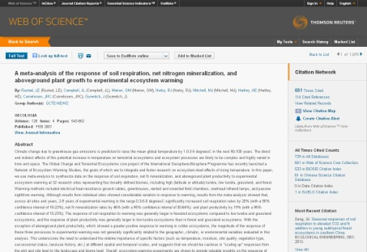
Searchable and Navigable
2004
2003
2008
Times Cited
2000
2009
2000
Cited References
1974
View Related Records
1998
2008
1993
2002
1999
2000

Slide 5
Web of Science can answer questions like…
What papers on a particular topic are the most highly cited?
Which authors have published the most papers on a particular topic?
What is the research output of an author?
What is the research output of a particular organization?
What agencies fund research on a particular topic?

Slide 6
Agenda
Search tips
Record Overview
Cited References
Related Records
Times Cited
Managing Results
Refine
Analyze
Citation Report
Saving Results
Marked List
EndNote
Search History/Alerts
Citation Alerts
Search Demos
Topic
Author
Organization/Address

Slide 7
Search logic and search assistance
best color match = best AND color AND match
“best color match” = best color match [phrase]
frog = frog OR frogs
color = color OR colour
best = good OR better OR best
loud = loud OR louder OR loudest
“color* match” = color match
colorful match

Slide 8
Wildcard Characters (Truncation)
Symbol | Retrieves | Example
* | Zero or more characters | ethyl* = ethylene ethylacetate ethylformamide *ethyl = methyl dimethyl *ethyl* = trichloroethylene methylpyridinium
$ | Zero or one character | eight$ = eight eighth eighty
? | One character only | en?oblast = entoblast endoblast
Topic searches must have at least 3 characters to use * wildcard.
Notes:
8

Slide 9
Search Operators
 | All search terms must occur to be retrieved. TOPIC: aspartame AND cancer Retrieves documents that contain both aspartame and cancer.
 | Any one of the search terms must occur to be retrieved. Use when searching variants and synonyms. TOPIC: aspartame OR saccharine OR sweetener Retrieves documents that contain at least one of the terms.
 | Excludes records that contain a given search term. TOPIC: aids NOT hearing Retrieves documents with aids, excluding any which also contain hearing.
Notes:
9

Slide 10
Proximity Operators
color theory = color AND theory
Phrase Searching | Exact matches for phrases can be found by searching on terms enclosed in quotation marks. Wildcard characters can be used inside quotation marks. “color theory” = color theory “color* theory” = color theory colorful theory
Near/ | Finds terms in the same field; user specifies proximity. Default is 15 words if user does not specify a number. color near/5 theory = color theory theory of color color plays a role in this theory theory. In this way, color…
Same | Terms must occur within the same sentence. Use in Address field only.
Notes:
10

Slide 11
Topic search
A topic search uses only the Title, Keywords, and Abstract fields

Slide 12
Topic search examples
Multiple Sclerosis and MRI
"multiple sclerosis" and (MRI or "magnetic resonance imaging")
black holes, galaxies, and gases via Spitzer Space telescope
spitzer and (“black hole*" or “galax*" or “gas*")
language development of bilingual children
"language development" and bilingual child*
global warming and the Arctic or Antarctica
("global warming" or "climate warming" or "climate change") and *arctic$

Slide 13
Cited References in plain text…why?
The reference is not indexed in the Web of Science.
The reference is in the Web of Science but…
It is outside your subscription.
The author has cited it incorrectly. The information the author used to cite that reference doesn't match what we have captured for that reference, so it doesn't link to the record page. We call this a citation variant.
Notice there is still Times Cited information, so you can still track that network of ideas and find related research even though you can't view that particular reference's full source record.

Slide 14
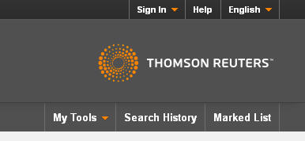
Create your Web of Science profile
Main benefits:
Roaming access
Save searches
Create alerts
Same login for ResearcherID and EndNote online.

Slide 15
Remote Access
Access outside of institutional network
Sign in and create a Web of Science profile (onsite)
6 months roaming access outside of institutional IP range
webofknowledge.com

Slide 16
Author Searches
Basic Search: Search by last name and first initial truncated * and then refine.
Author Search feature: 3 step process that connects author name to research domain and organization.
Christopher Reynolds, Dept. of Astronomy-Univ Maryland
Previously at NASA, University of Cambridge, University of Colorado Boulder
Cormac Reynolds, ResearcherID: B-5635-2013
Notes:
We only started indexing full author names in 2007.

Slide 17
Organization/Address Searches
What is the research output of a particular organization?
Medical Center, Loma Linda University
Organization-Enhanced field
Search by Preferred/Unified organization name or a more narrow, variant name
2700 organizations have been unified with ongoing work to unify many more

Slide 18
Organization/Address Searches
Address vs. Organization-Enhanced
The Address field in Web of Science searches non-unified forms of all article addresses, as well as city, country, postal code, etc.
Use the Address field to find papers written by authors in a particular institution that lacks an Organization-Enhanced entry.
Portland Community College (Oregon)

Slide 19
Saving results / Setting alerts
Marked List
Up to 5000 references can be added
Search History
Saving your results
Marked List
Print / Email / Tab-delimited / EndNote
Up to 500 references can be output at a time
Save search history
Email alerts
Search alerts
Citation alerts

Slide 20
Working with your results
Citation Reports
Shows how much citation activity is going on for a result set
Usually created after an author or organization search
Analyze Results
Who are the top authors at an institution?
What are the top funding agencies for a particular research topic?
Which institutions publish a lot on a particular research topic?

Slide 21
Web of Science and PubMed
 | PubMed | Web of Science
Topic search | Controlled subject vocabulary = precise search results | Title, Keyword, and Abstract
Discover related research |  | Connections via citation activity
Interdisciplinary | Biomedical sciences | Yes (Chemistry, structural biology, biophysics, or other “less medical” topics)
Citation counts | No | Times cited & Cited references

Slide 22
Support and Training
Technical Support
For access, content, searching, troubleshooting and
technical issues.
http://ip-science.thomsonreuters.com/techsupport/
Training
For product or IP-related training options.
http://thomsonreuters.com/products_services/science/training/

