Slide 1

Engaging Research Students via Team-Based Learning:
A Tale of Two Programs
Karen Mainess & Donna Thorpe
Faculty Development Showcase
Thursday, February 27, 2014

Slide 2
“Flipping the Classroom”
A new buzz word!
The New York Times (Fitzpatrick, 2012)
The Chronicle of Higher Education (Berrett, 2012)
Science (Mazur, 2009)
Notes:
Flipping the classroom” has become something of a buzzword in the last several years, driven in part by high profile publications in: The New York Times (Fitzpatrick, 2012);
The Chronicle of Higher Education (Berrett, 2012); Science (Mazur, 2009)

Slide 3

Flipping the classroom means . . .
Students gain first exposure to new material outside of class
  Reading
  Lecture videos, etc
Then use class time to do the harder work of assimilating that knowledge, perhaps through:
  Problem-solving
  Discussion
  Debates

Slide 4
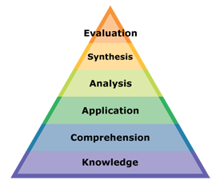
According to Bloom’s Taxonomy (revised, 2001)…
Team-Based Learning (TBL) students are doing:
  Lower levels of cognitive work outside of class:
    Gaining knowledge
    Comprehension
  Higher forms of cognitive work are focused on in class:
    Application
    Analysis
    Synthesis
    Evaluation
Notes:
According to Bloom’s Taxonomy (revised, 2001), Team-Based Learning (TBL) students are doing: Lower levels of cognitive work outside of class: Gaining knowledge & Comprehension. Higher forms of cognitive work are focused on in class: Application, Analysis, Synthesis, & Evaluation

Slide 5

Traditional Model
First exposure occurs via lecture in class
Student assimilate knowledge through homework
With the present model, this process is “flipped”.
Notes:
This model contrasts from the traditional model in which “first exposure” occurs via lecture in class, with students assimilating knowledge through homework; thus the term “flipped classroom.”

Slide 6
Theoretical Basis for TBL
Team-Based Learning (TBL) = Constructivist learning (Svinicki 2004; Kaufman 2003)
  Focus is on the mental representation of information by the learner”
Notes:
Team-Based Learning (TBL) incorporates the main elements of constructivist learning: Focus is on the mental representation of information by the learner” (Svinicki 2004; Kaufman 2003)

Slide 7

Constructivist Learning
The teacher guides or facilitates learning.
Learners should encounter conflict with former knowledge and new knowledge
Relevant problems accompanied by group interaction promotes learning.
Learning requires reflection.
Notes:
The teacher is a guide to facilitate learning. Learners should encounter inconsistencies between preconceptions and new experiences to provide a basis for development of new understandings.
A focus on relevant problems accompanied by group interaction promotes learning. Learning requires reflection.

Slide 8

TBL Consistent with All of These Elements
Teacher as facilitator:
  Establishes the learning objectives
  Chooses the problems of focus
  Guides teams toward solutions
Notes:
Teacher establishes the learning objectives and chooses the problems on which the students will focus, But then acts as a guide while teams work toward their solution to the problem.

Slide 9
Learners encounter inconsistencies in preconceptions and new experiences:
  A careful choice of problems can help reveal common student misconceptions
Focus on relevant problems + Group interaction = Learning
  Constant interaction and debate → comparison of current understandings with those of other team members → new understandings
Notes:
Learners encounter inconsistencies in preconceptions and new experiences: A careful choice of problems can help reveal common student misconceptions
Focus on relevant problems + Group interaction = Learning Constant interaction and debate among team members allows learners to compare their current understandings with those of other team members and to construct new understandings.

Slide 10
Learning Requires Reflection
TBL provides several opportunities for reflection:
  During the group readiness assessment test
  While hearing other teams’ reports of their conclusions
  During the peer evaluation process, which often includes self-evaluation.
Notes:
TBL provides several opportunities for reflection:
During the group readiness assessment test
While hearing other teams’ reports of their conclusions
During the peer evaluation process, which often includes self-evaluation.

Slide 11
What Is Team-Based Learning?
A structured form of small-group learning that
  Emphasizes student preparation out of class
  Application of knowledge in class.
Notes:
Team Based Learning(TBL) is a structured form of small-group learning that emphasizes student preparation out of class and application of knowledge in class.

Slide 12

Students organized strategically
  Diverse teams of 5-7 students
  Teams work together throughout the class.
Students prepare by reading prior to class.
Notes:
Students are organized strategically into diverse teams of 5-7 students that work together throughout the class.
Before each unit or module of the course, students prepare by reading prior to class.

Slide 13

Readiness Assurance Process
At the beginning of class
  Students participate in a Readiness Assurance Process (RAP)
    Part 1: Individual Readiness Assurance Test (iRAT)
Notes:
In the first class of the module, students participate in a “Readiness Assurance Process,” or RAP.
Specifically, students complete a test individually (the “Individual Readiness Assurance Test,” or iRAT).

Slide 14
Group Readiness Assurance Test
Part 2: Complete same test with their group members
  Group Readiness Assurance Test (gRAT)
Notes:
They then complete the test with their group members (the “group Readiness Assurance Test,” or gRAT).
Both the individual scores and the group scores contribute to the students’ grades.
The tests are typically multiple choice
Students often complete the group test using a “scratch-off” sheet and score themselves
Reduces grading time and promotes student discussion of correct answers.

Slide 15

Appeal Process
After group test, teams encouraged to appeal questions that they got wrong.
Encourages students to:
  review the material
  evaluate their understanding
  defend their choices
Notes:
After the students complete the group test, the instructor encourages teams to appeal questions that they got incorrect. The appeals process encourages students to review the material, evaluate their understanding, and defend the choice they made.

Slide 16

After RAP process, instructor lectures briefly
  Highlighting concepts which students are struggling with
Notes:
To conclude the Readiness Assurance Process, the instructor gives a mini-lecture that focuses on concepts with which students struggled the most.

Slide 17
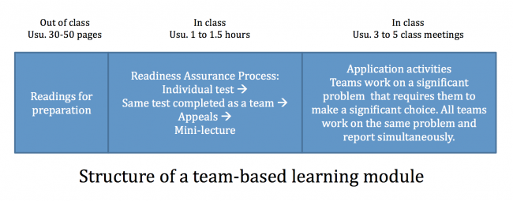

Slide 18
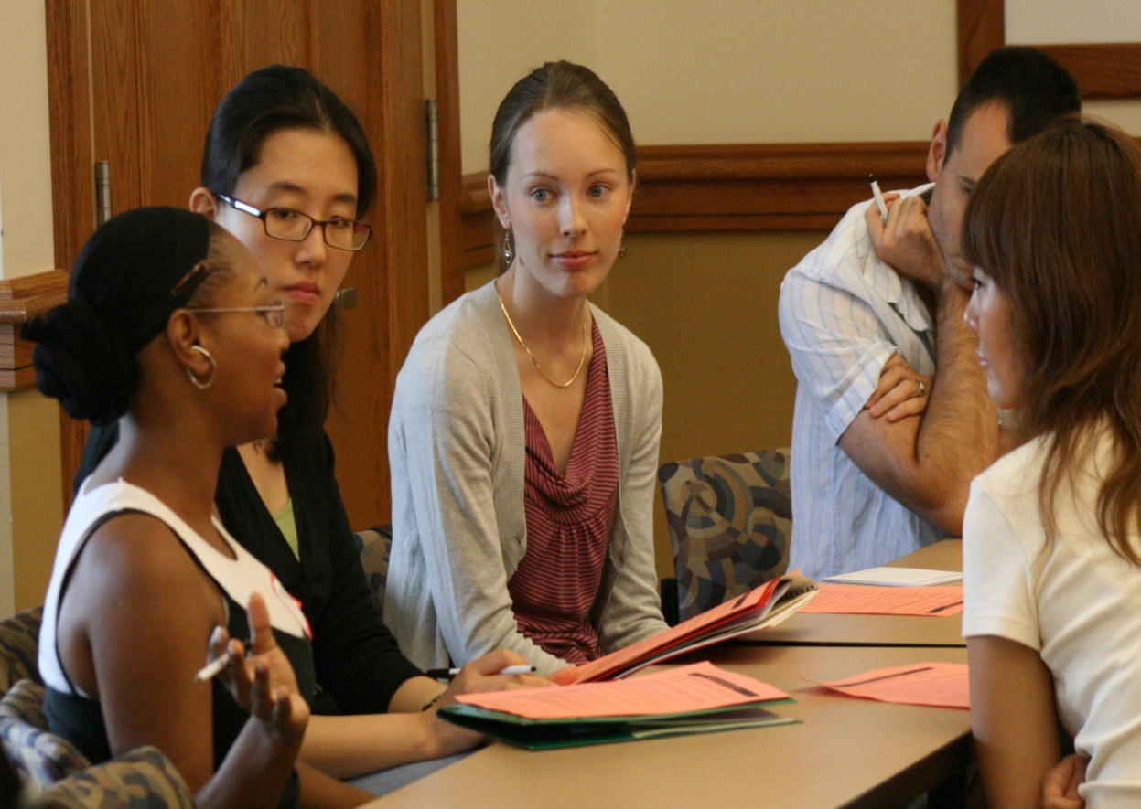
In-Class Application Activities
All prior activity →preparation for the in-class application activities that complete the module.
Require teams to make a specific choice about a significant problem.
All teams work on the same problem and report their decisions simultaneously.
Notes:
Out of Class Preparation → Readiness Assurance Process →Mini Lecture
Serve as preparation for the in-class application activities that complete the module.
These application activities require the teams to make a specific choice about a significant problem.
All teams work on the same problem and report their decisions simultaneously.
This structure requires teams to articulate their thinking, and gives teams an opportunity to evaluate their own reasoning when confronted with different decisions that other teams may make.

Slide 19
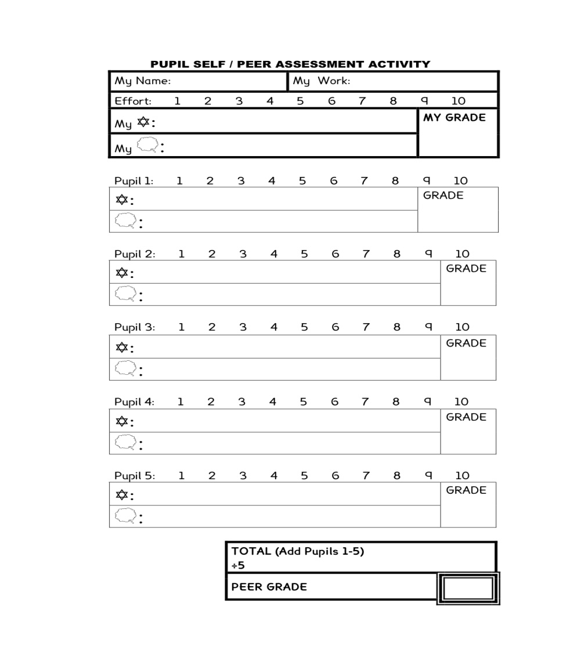
Peer Evaluation
Important part of TBL
Keeps students accountable to their teammates
Notes:
Peer evaluation is an important part of team-based learning
It is seen as essential for keeping students accountable to their teammates.

Slide 20

Post Professional
Masters and Doctoral Physical Therapy Programs

Slide 21

Research I
Three unit class
One class/week
7- 9:50 pm
International students

Slide 22


My Motivation
To generate active learning in the classroom.
To engage students in learning from one another
To assure that assigned readings were completed before class.

Slide 23

Week 1 : Establishing the Team Process
Assigning students to teams
Participation in weighting 2* of 3 grading criteria
  Individual work (Quizzes, Exams)
  Group work (Quizzes, Exams)*
  Team Maintenance (Peer Evaluation)*
Practicing Team Learning Process

Slide 24
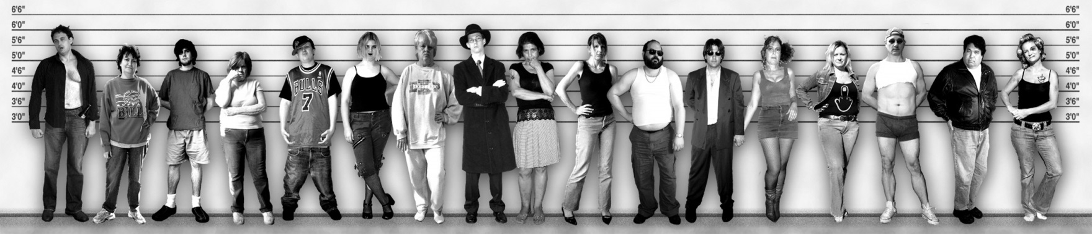
Assigning Students to Teams
7-8 students to a team
Total of 6 teams.
Teams representative of diversity of country of origin (9) and gender
Random process of assignment in class.

Slide 25

Weighting Grading Criteria
Each team decided on weighting for grading.
  Group Work (Quizzes, Exams)*
  Team Maintenance (Peer Evaluation)*
Reps from each team established consensus for class.

Slide 26



Practicing the Team Learning Process
Group took same RAT.
Key to RAT distributed
Writing an appeal.
Students read course syllabus quietly
Each took the Readiness Assessment Test (RAT) individually on syllabus content

Slide 27

Pre class Materials
A one page handout for each week’s assignment
  Specific Questions on key terminology and concepts
Power point lectures

Slide 28

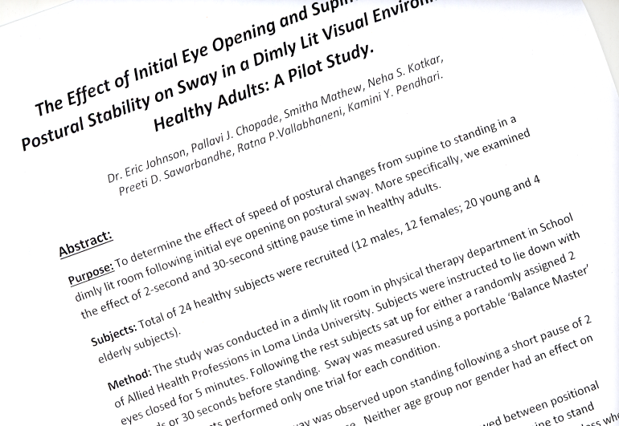
Team Activities
Ungraded.
Centered around research abstracts:
  Identify Implied Research question(s)
  Identify variables
  Classify research study designs
  Identify threats to validity
  Select study with highest quality of evidence for effectiveness of a specific treatment .

Slide 29


Team Maintenance – Peer Eval
Each member gives a teamwork score to each team member except self.
Total points to distribute: 10x(number teammates)
Highest score no < 11
Lowest score no >9
Student must give reason for the highest and lowest score.
Personalized feedback comments given to each student anonymously upon request.
Conducted at midterm and final. Only final “counted”.

Slide 30


Team Member Feedback
“_____: is a good representative..[for] the group. She makes sure that everyone understands the discussions and gives everyone a fair chance to speak.”
  “_____He’s the voice of dissent in our group. He encourages us to look at questions from a different point of view. He studies the material thoroughly, so he’s good at catching minor hints or flaws”

Slide 31

Team Member Feedback
Growth
  _____“He has shown tremendous improvement since the last peer evaluation. He is well prepared before class and plays an active role in group discussion”.
Encouragement
  “_______ ..need to take an active part in discussions, because I know they study well and their opinion could be valuable.”

Slide 32

Student Feedback
“This is the best class I have ever taken”
“I learned far more by having to dig it out for my self than I would have from listening to lectures”
Course eval score for “I was challenged intellectually” higher than previous lecture format.

Slide 33

Student Feedback
Students not “taught” by the teacher.
Perceived sense of disorder/disorganization
Too much work

Slide 34

My Observations
Orientation to the class took 1½ class periods. Arriving at consensus on grading took much longer than expected.
Would not have been possible without an assistant due to class size.

Slide 35

What I Would Do Differently…
Add more time for mini lectures on more difficult concepts.
Reduce time spent on quizzes
  Fewer, easier questions
Reduce group activity time by assigning some as homework.
Reduce group size to 6 (7 MAX)

Slide 36

Dept of Communication Sciences & Disorders
Master of Science Degree Program

Slide 37
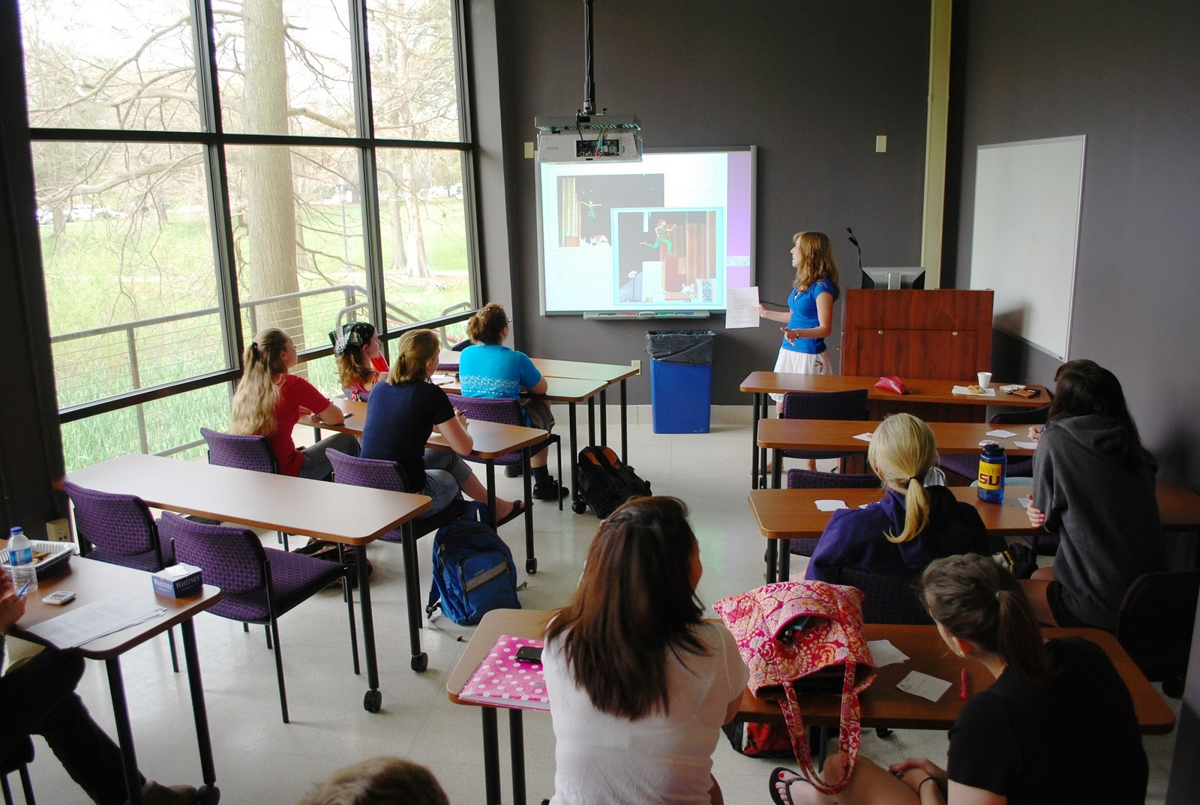
My Motivation
90% of grad level courses in the dept taught by problem-based learning (PBL)
  Requires students work in small groups to solve clinical problems based on a video presentation of real life cases.
Not appropriate for a research class
Needed an active learning opportunity outside of traditional lecture format
Notes:
70% of grad level courses in the dept taught by problem-based learning
Requires students to work in small groups to solve clinical problems based on a video presentation of real life cases.
This process not appropriate for a research class
Needed a way to provide students with active learning opportunities outside of traditional lecture format

Slide 38

Week 1: Establishing Small Groups
Goal: heterogeneity
  Undergrads from LLU vs. other schools
  Research vs no research background
  Local vs Out-of-State students
Divided into groups of 6
Team leaders chosen
  Leader from each team caucused to agree on weighting of iRATs, gRATs, and Peer evals
Notes:
To keep the groups as heterogeneous as possible, divisions included
Undergrads from LLU vs. other schools
Research vs no research background
Local vs Out-of-State students
Divided into groups of 6
Team leaders chosen
Leader from each team caucused to agree on weighting of iRATs, gRATs, and Peer evals

Slide 39

Format each following week
Reading assignments for each week posted on CANVAS
  Study guide
  Textbook chapters
  PowerPoint lectures
  Written handouts

Slide 40

First Activity of the Day
Individual Readiness Assurance Test (iRAT) administered
  10 point quiz
  8-10 items
  Multiple choice

Slide 41
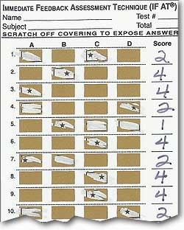
Next Activity
Group Readiness Assurance Test (gRAT)
  Same test
  Students in their assigned groups
  Discuss answers before scratching off covering to expose correct answer
Notes:
Immediate feedback. Opportunity to learn other points of view from group peers

Slide 42
Appeal Process
Student have opportunity to challenge test responses which they got wrong (in their groups)
  Must use reading material to support their appeal
  If instructor agrees, the lost point(s) are restored to the group

Slide 43

20-30 Minute Lecture
Highlighting concepts which students are having more difficulty with
Allows students to get clarification of individual questions

Slide 44

Group Activities
Following lecture, small groups convene for generalization activities
  All groups work on the same problems
  Instructor is available to guide students when assistance is requested
  Groups uploaded completed activities to CANVAS
  A group grade was assigned for correct completion

Slide 45
Peer Evaluation
Peers evaluated each other near the end of the quarter
  Not allowed to give all group members the same score
  Had to determine how much they felt each member had contributed to the group
  Percentage of their grade included these cumulative scores

Slide 46
Results
The groups bonded over time.
  As a result, quieter students were more willing to contribute to the discussions
  Students were not willing to “penalize” each other with the peer evaluations
Fear of “not learning anything” because there was not much lecture
Students appreciated the immediate feedback afforded by the testing process
Motivated students to prepare in advance of class

Slide 47

What I would do differently
Perhaps more lecture time on more complex issues
Not sure I would continue to use the peer evaluations
No grade for group activities
Course feedback earlier in the quarter
Notes:
(not sure how to motivate the groups to complete them if not graded though…)
Perhaps middle and end

Slide 48
What we both found
Increased anxiety initially
Negative Initial response to giving feedback
polarizing response to format by the end
Lecture still important component

Slide 49


Slide 50
Contact Us
kmainess@llu.edu
dthorpe@llu.edu

Slide 51
References
Anderson LW and Krathwohl D (2001). A taxonomy for learning, teaching, and assessing: a revision of Bloom’s taxonomy of educational objectives. New York: Longman.
Berrett D (2012). How ‘flipping’ the classroom can improve the traditional lecture. The Chronicle of Higher Education, Feb. 19, 2012.
Bransford JD, Brown AL, and Cocking RR (2000). How people learn: Brain, mind, experience, and school. Washington, D.C.: National Academy Press.
Crouch CH and Mazur E (2001). Peer instruction: Ten years of experience and results. American Journal of Physics 69: 970-977.
DesLauriers L, Schelew E, and Wieman C (2011). Improved learning in a large-enrollment physics class. Science 332: 862-864.

Slide 52
Fitzpatrick M (2012). Classroom lectures go digital. The New York Times, June 24, 2012.
Hake R (1998). Interactive-engagement versus traditional methods: A six- thousand-student survey of mechanics test data for introductory physics courses. American Journal of Physics 66: 64-74.
Hrynchak P and Batty H. (2012) The educational theory basis of team-based learning. Medical Teacher 34: 796-801.
Kaufman DM. (2003). Applying educational theory in practice. BMJ 326: 213-216.
Koles PG, Stolfi A, Borges NJ, Nelson S, Paremelee DX. (2010). The impact of team-based learning on medical students’ academic performance. Academic Medicine. 85: 1739-1745.

Slide 53
Lage MJ, Platt GJ, and Treglia M (2000). Inverting the classroom: A gateway to creating an inclusive learning environment. The Journal of Economic Education 31: 30-43.
Levine RE, O’Boyle M, Haidet P, Lynn DJ, Stone MM, Wolf DV, and Paniagua FA. (2004). Transforming a clinical clerkship with team learning. Teach Learn Med 16: 270-275.
Mazur E (2009). Farewell, Lecture? Science 323: 50-51.
Michaelsen, L, Bauman-Knight, A, and Fink, D. (2003). Team-based Learning: A Transformative Use of Small Groups in College Teaching. Sterling, VA: Stylus Publishing
Michaelsen, L, Parmelee, D.X., McMahon, K. K., and Levine, R. E. (2007). Team- Based Learning for Health Professions Education A Guide to Using Small Groups for Improving Learning. Sterling, VA: Stylus Publishing

Slide 54
Novak G, Patterson ET, Gavrin AD, and Christian W (1999). Just-in-TimeTeaching: Blending Active Learning with Web Technology. Upper Saddle River, NJ: Prentice Hall.
Pashler H, McDaniel M, Rohrer D, and Bjork R (2008). Learning styles: Concepts and evidence. Psychological Science in the Public Interest 9: 103-119.
Svinicki MD. (2004) Learning and motivation in the postsecondary classroom. San Francisco: Anker Pub. Co.
Walvoord BE, and Anderson VJ (1998). Effective grading: A tool for learning and assessment. San Francisco: Jossey-Bass.
Zgheib NK, Simaan JA, and Sabra R. (2010). Using team-based learning to teach pharmacology to second year medical students improves student performance. Med Teach 32: 130-135.

